Slide 1
Indian Stock extraction, analysis and Prediction
Group 25:
Abhishek Reddy (21111062)
tareddy21@iitk.ac.in
Deepak Kumar (21111023)
dkumar21@iitk.ac.in
Mandar Dhake (21111405)
mkdhake21@iitk.ac.in
Yash Patil (21111410)
yashpp21@iitk.ac.in
Guided By:
Prof. Arnab Bhattacharya

Slide 2
Problem Statement
❖A project to thoroughly analyse and predict the Indian stock market so that users can invest effectively.

Slide 3
Motivation
The stock market is most trending topic.
Since covid most of the money has shifted from goods and services to investment because of the lockdown.
Hence, many people started showing interest in stock market.
To help these users keep up with the current trends we decided to build a system that can help people while investing in the market.

Slide 4
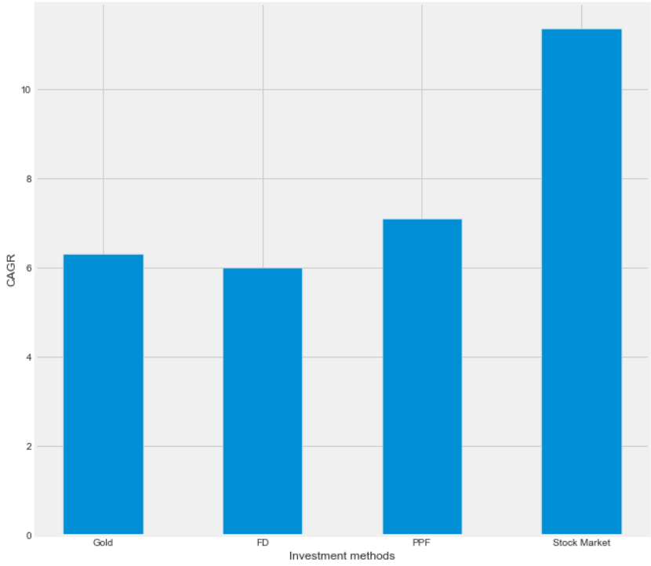
Introduction
The common options for investment are Gold, FD, PPF, Real Estate(but it is illiquid form of investment) and Stock market.
The adjacent graph shows the CAGR(Compound Annual Growth Rate) of the investment methods.
The Stocks can give upto 11% annual interest without any risk.
But it is too much volatile, requires lots of attention.
This is when our system helps.

Slide 5
Data Extraction
We needed data of different companies for different period of time, till the current day. Hence we scraped the data from online websites
The steps followed to scrape the data are as follows:
Initialize the web driver with url of website
Emulate clicks to add filters to the site so that we can extract required data
Define the lists to store extracted data.
Scrape the data from the site into previously defined lists with each list containing
Replace the null values, "-", or " " with Nan which can be handled easily in python
We extracted 2 datasets the overall performance of all the national companies over 5 years and the daily performance of selective companies for a certain period of time

Slide 6
The overall performance dataset of all national stocks
The extracted features of dataset are as follows:
Stock name : Names of the company’s stock.
Sub-sector : Depends on product or service they provide.
Market Cap : Market Cap Price of the stock i.e market value of stock.
Closing Price : The close price from the day company’s stock last traded
PE ratio : Close price divided by the earnings per share, excluding extraordinary items of the company’s stock.
Five Year Growth : Compounded annual growth rate of the company’s stock price over previous 5 years.
Alpha : Excess return of a company’s stock relative to its benchmark, calculated using 104 weekly price close points of the stock.
Beta : Measure of a company’s stock price volatility relative to the market.
Five Year Historical Revenue Growth : The annual compounded growth rate of revenue over the last 5 years of a company’s stock

Slide 7
The daily performance dataset of various companies
The extracted features of dataset are as follows:
Date: The day of accounting
High: The highest price the stock reached in whole day.
Low: The lowest price the stock reached in whole day.
Open: The opening price of the stock.
Close: The closing price of stock.
Volume: Volume measures the number of stocks traded throughout the day
Adj Close: The adjusted closing price is a stock’s closing price to reflect the stock’s value after accounting for any corporate actions.
The derived features of stocks are as follows:
Daily returns: The rate of change of daily closing price.
Trends: The attribute based on daily return like positive or negative change.
Simple Moving Average: Gives an idea of average price of stocks for certain intervals
Volume Weighted-Average Price: Average price is found using volume

Slide 8
Classify the Stocks into large cap, middle cap, small cap categories
We classified the data into these categories so that it is better to analyse
The large cap companies are least volatile hence, good for analysis
While if we analyse the small companies which are too much volatile, the analysis may not be fruitful as they change rapidly

Slide 9
Sort the large cap companies to select top companies
We sorted the companies so that we can evaluate top companies first to have better results
For sorting we used three parameters beta, alpha and 5 year growth in this order, as growth is most important parameter for any company.
Beta : Measure of a company’s stock price volatility relative to the market
Alpha : Excess return of a company’s stock relative to its benchmark, calculated using 104 weekly price close points of the stock.
Five Year Growth : Compounded annual growth rate of the company’s stock price over previous 5 years.
The top companies are used for analysis and prediction

Slide 10
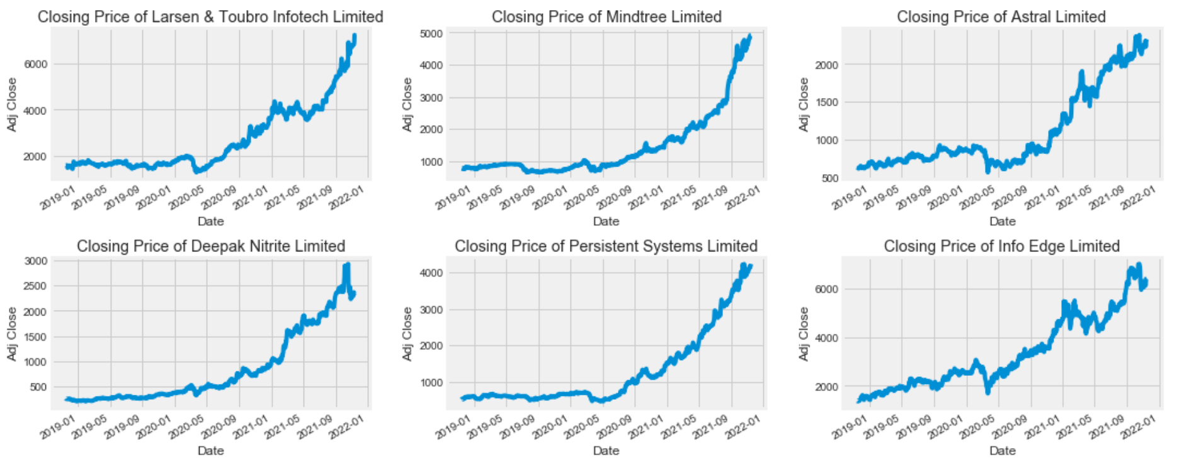
Analyse the Closing price trends

Slide 11
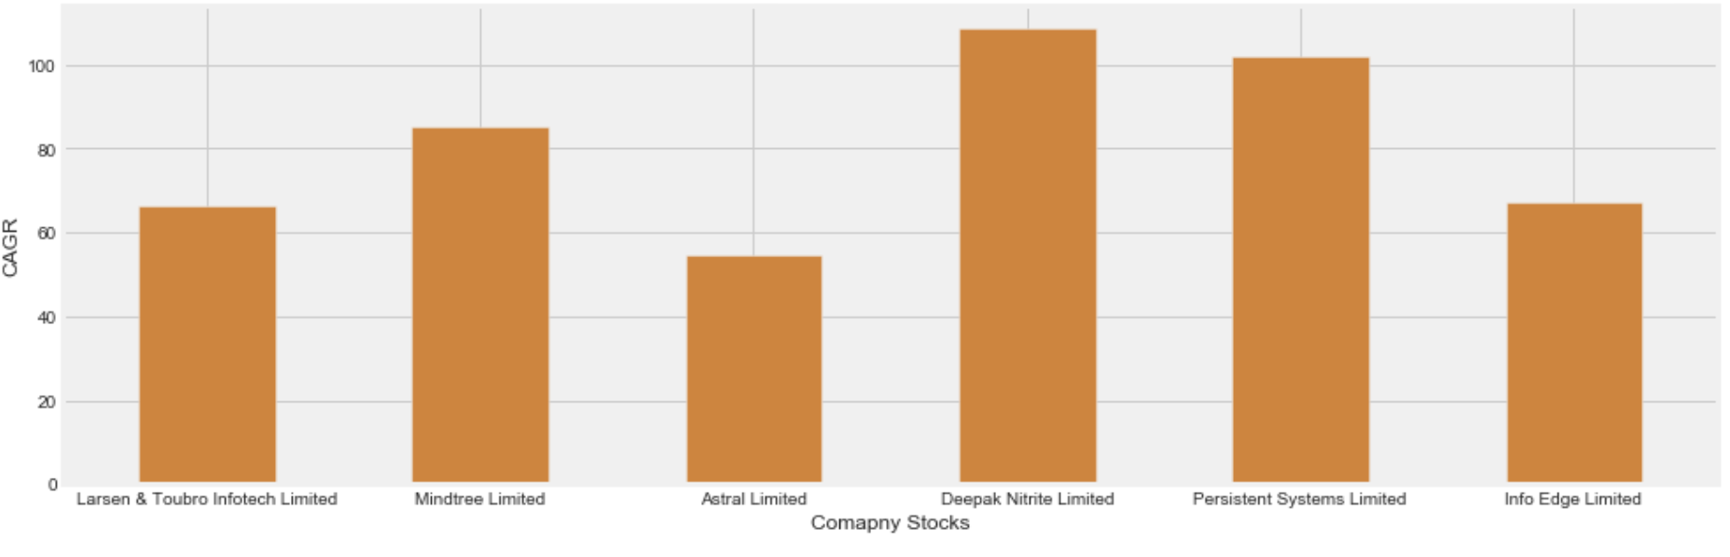
Analyse the CAGR of different Stocks

Slide 12
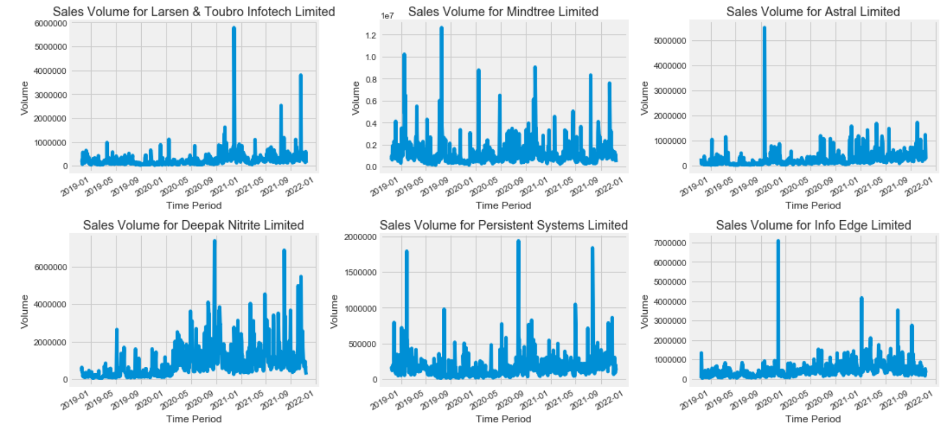
Analyse the Volume trends

Slide 13
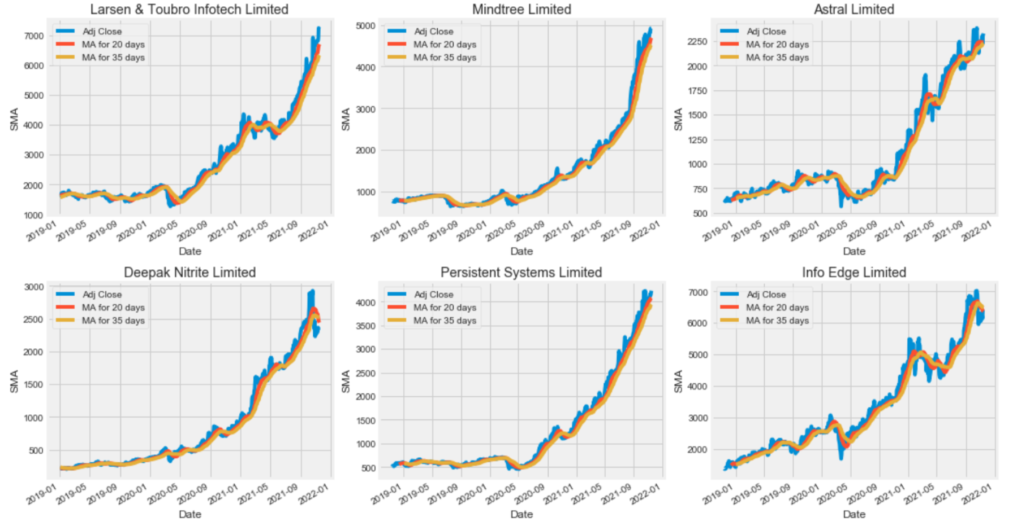
Analyse the Simple Moving Average for different intervals

Slide 14
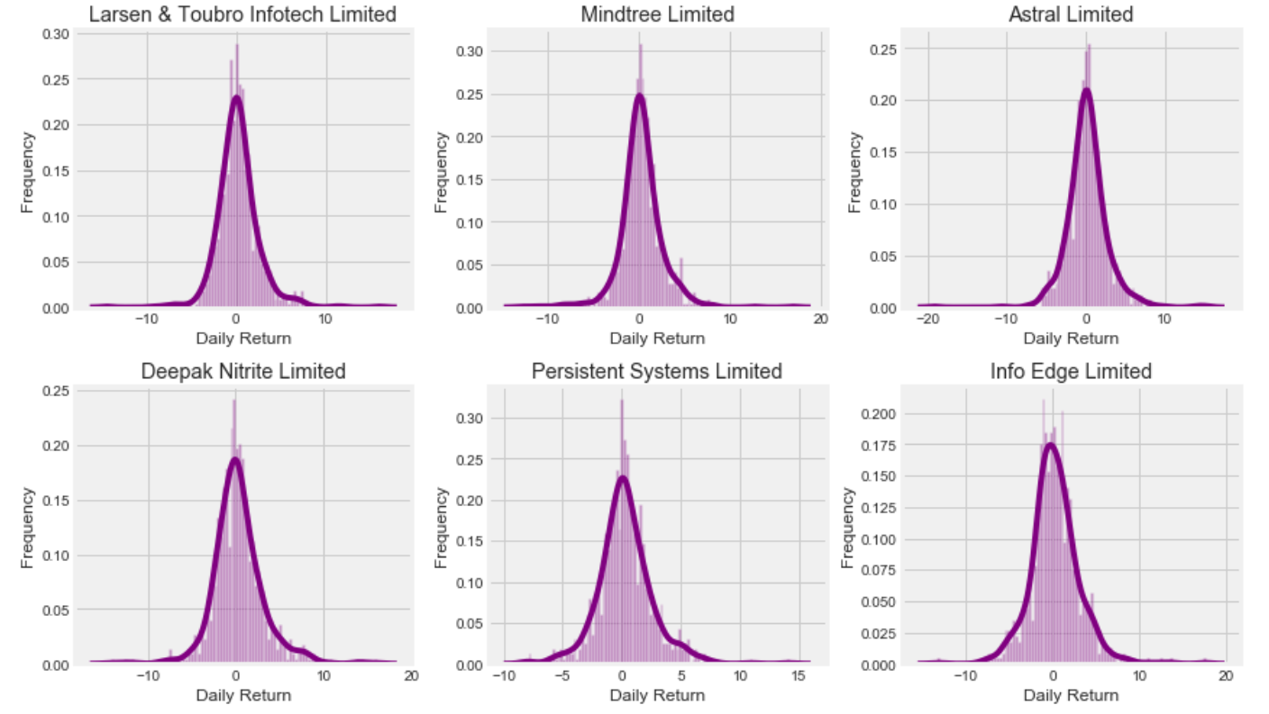
Analyse the Daily returns trends

Slide 15
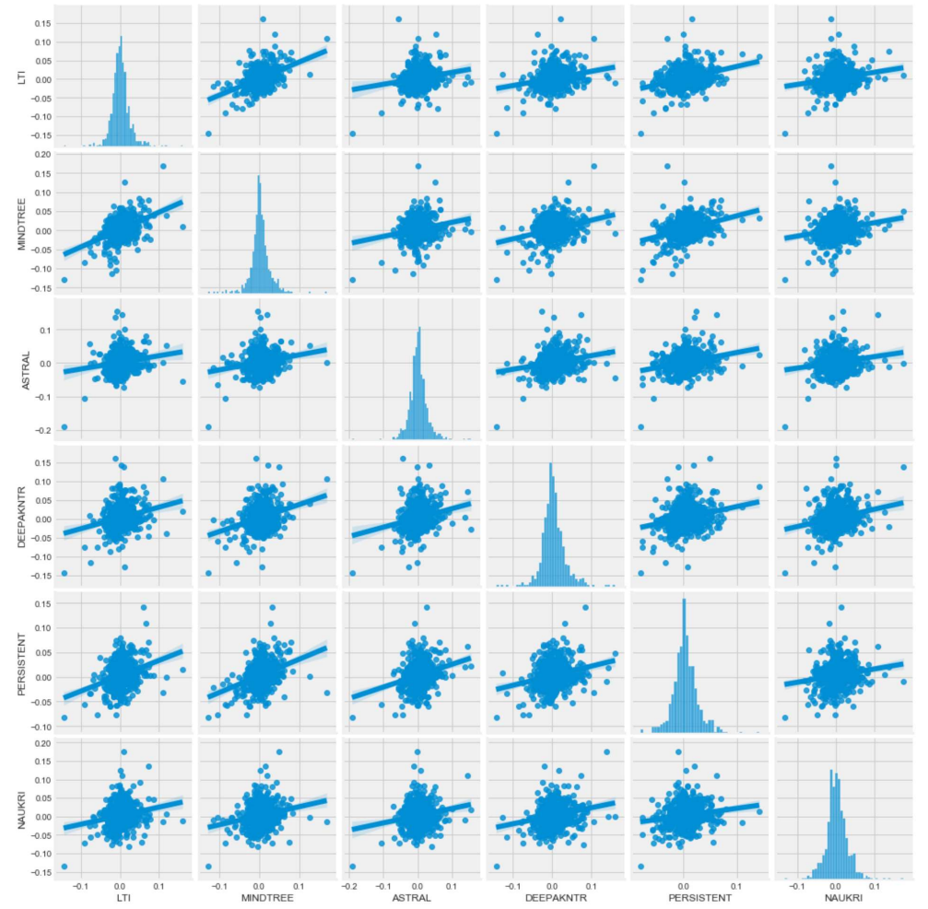
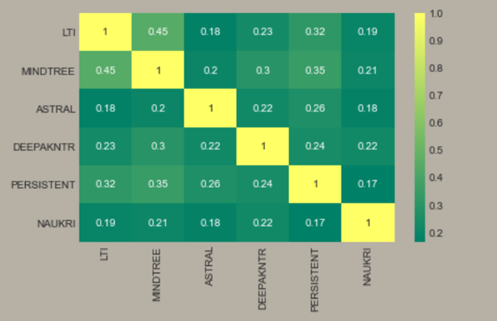
Analyse the Correlation between different Stocks

Slide 16
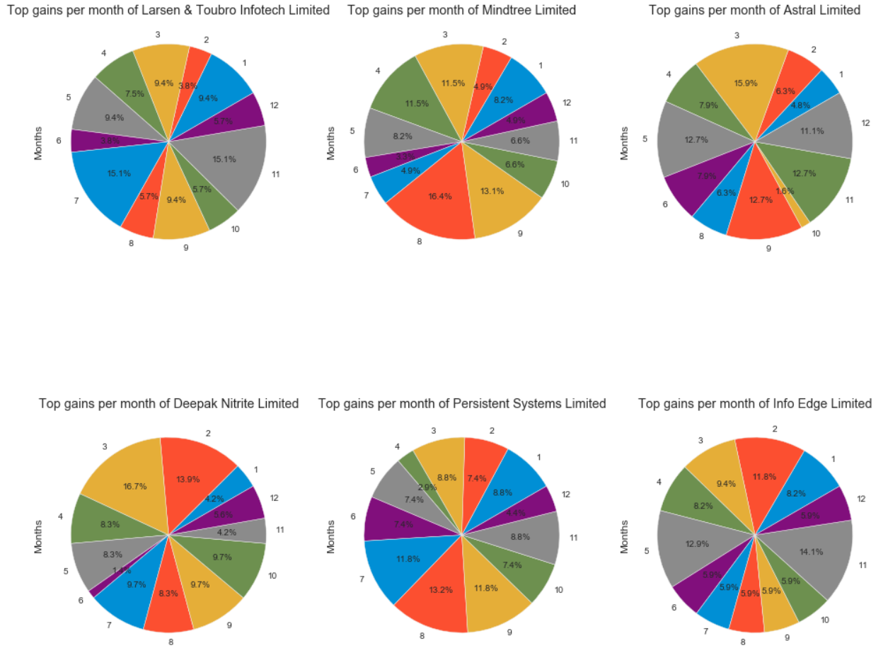
Analyse the top gains per month for different stocks

Slide 17
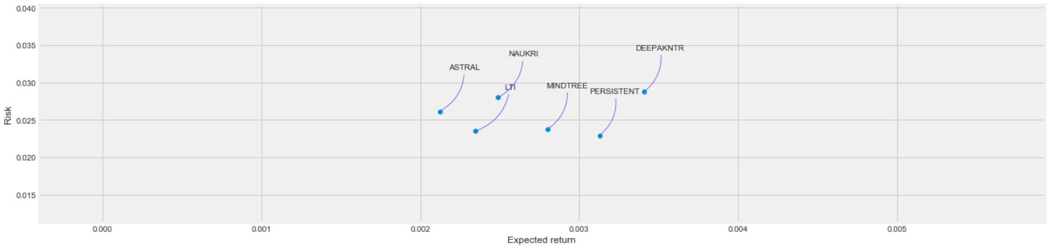
Risk Analysis using mean and standard deviation of daily returns

Slide 18
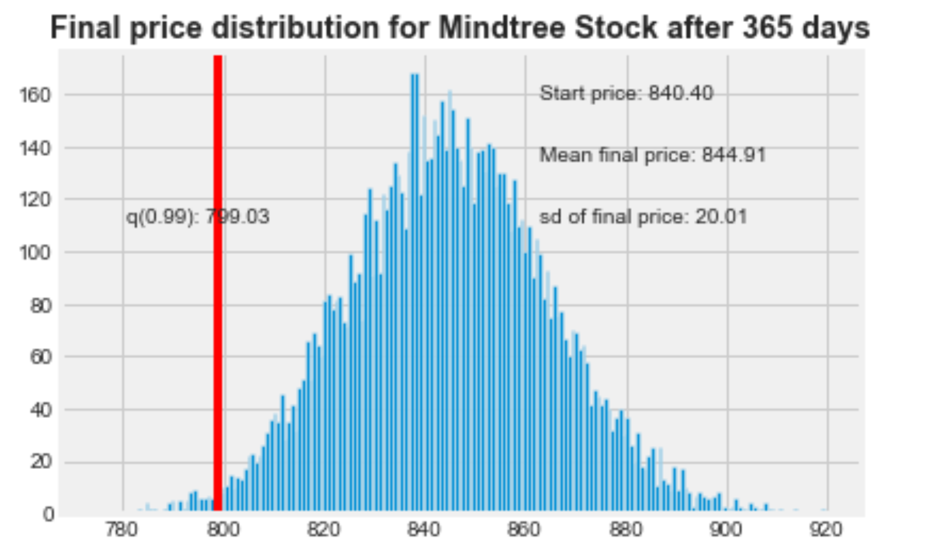
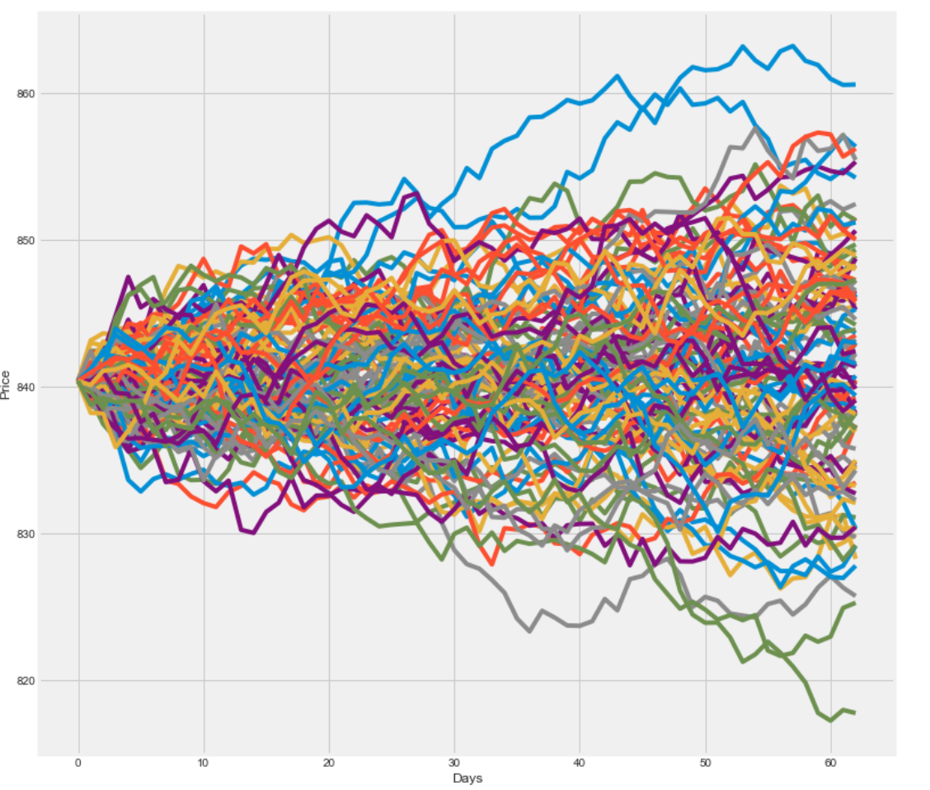
Risk analysis by Monte Carlo Simulations

Slide 19
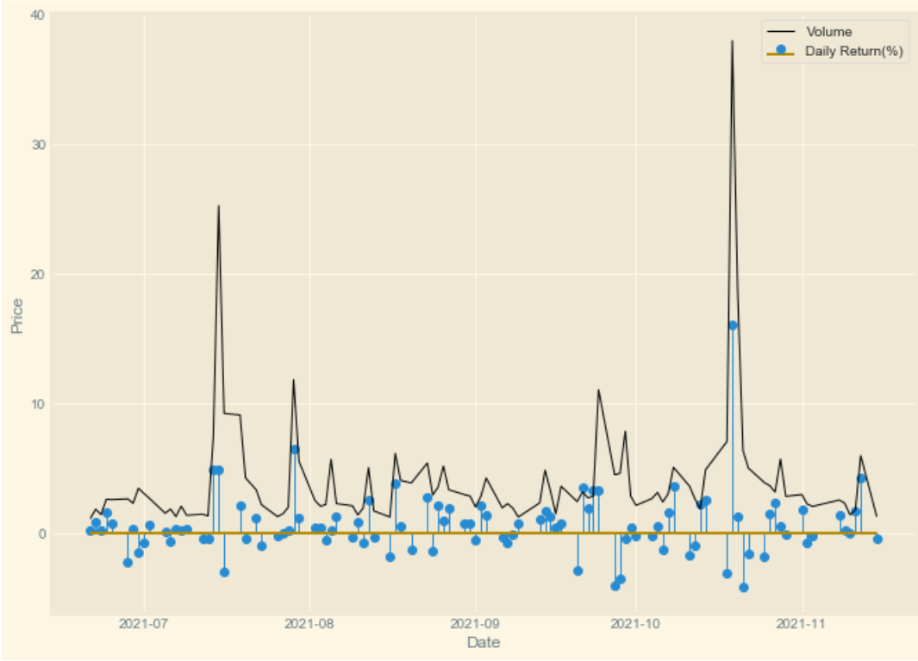
Comparison between Volume and Daily returns

Slide 20
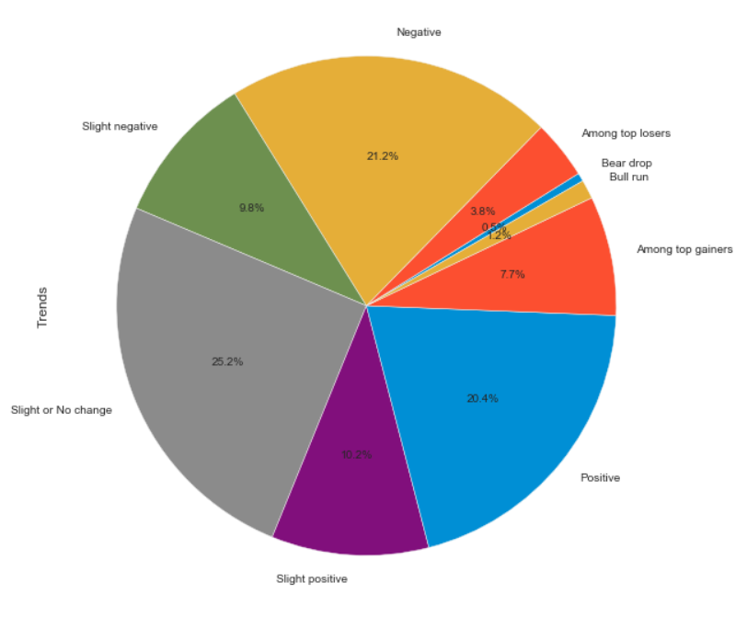
Analyse the LTI trend distribution

Slide 21
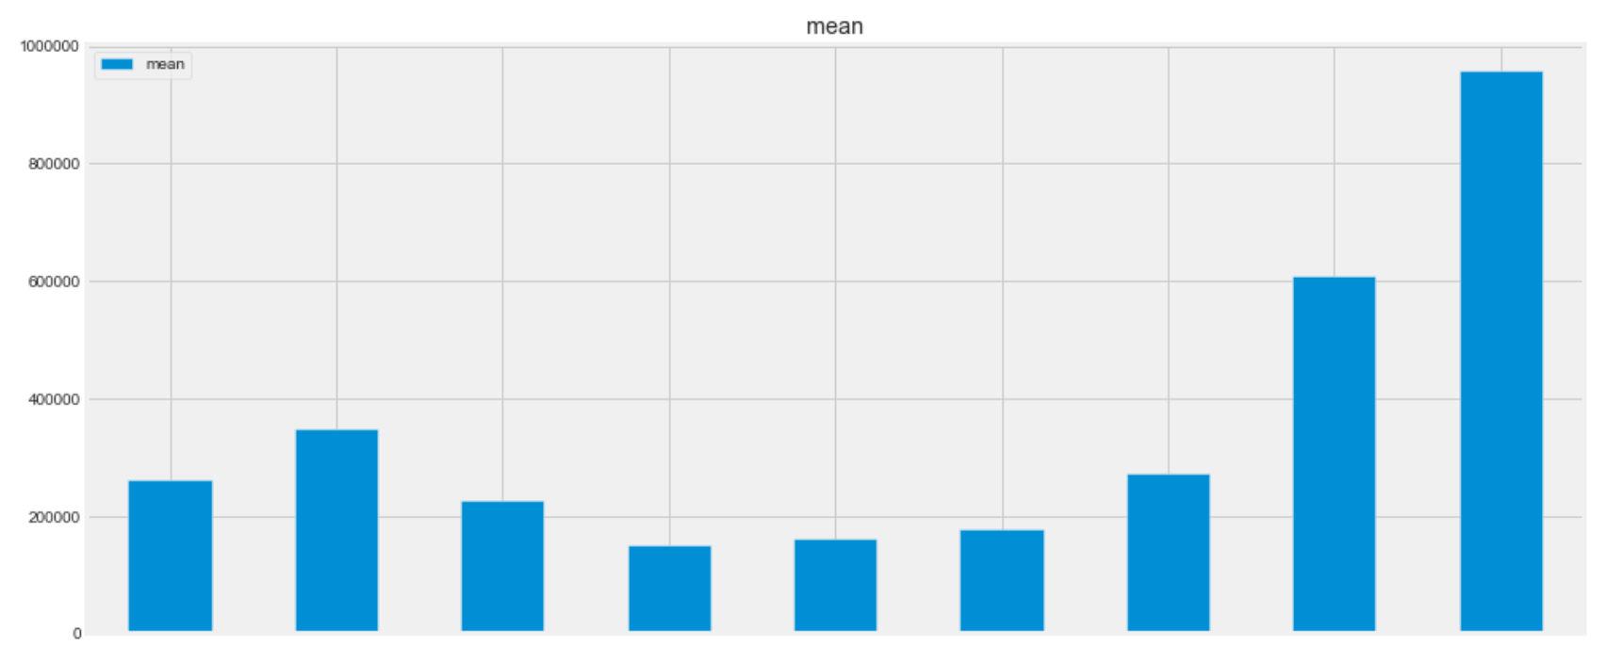
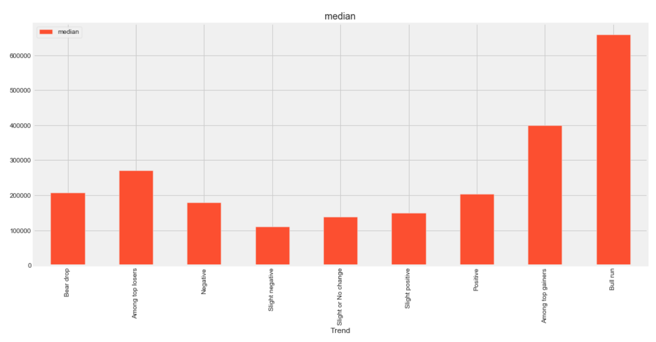
Analyse the average volume for different trends of LTI

Slide 22
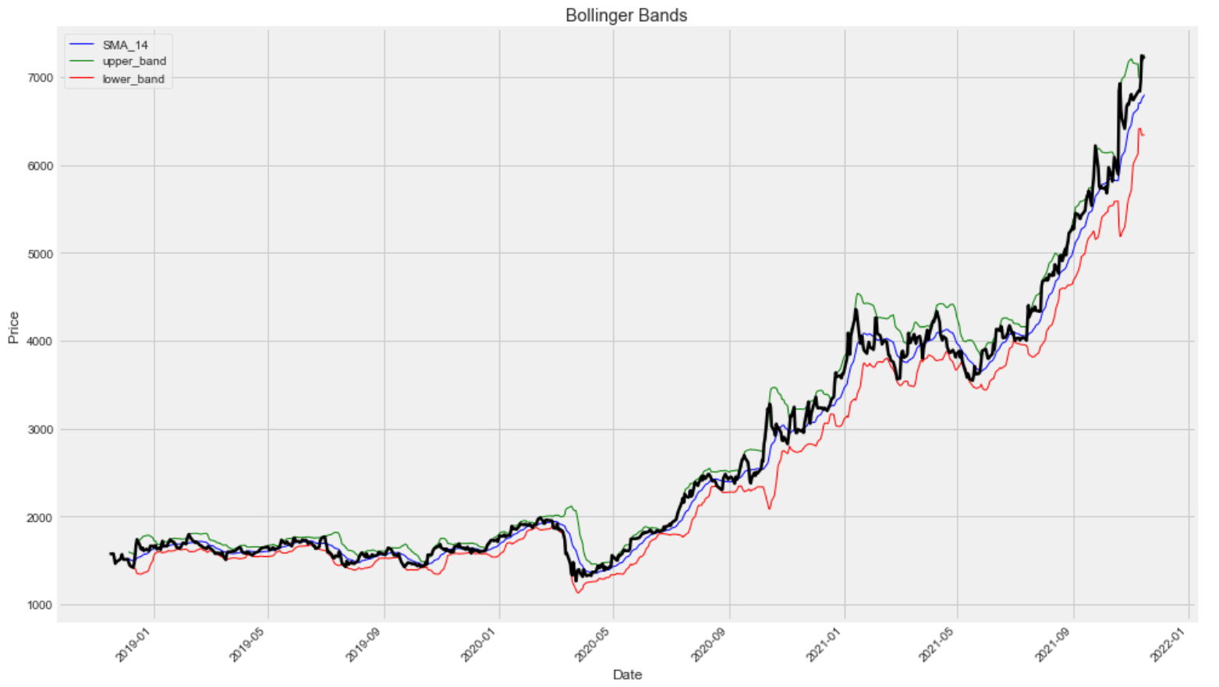
Trade Calls using Bollinger bands

Slide 23
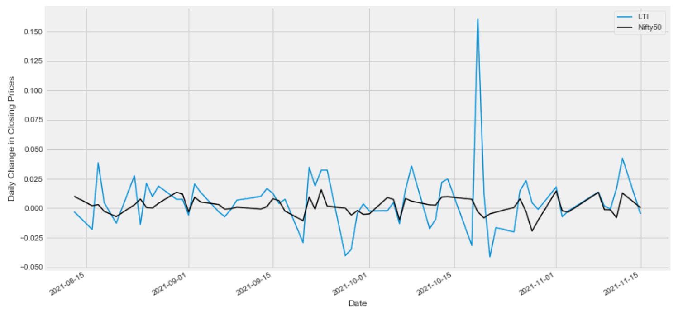
Beta comparison of LTI vs Nifty50

Slide 24
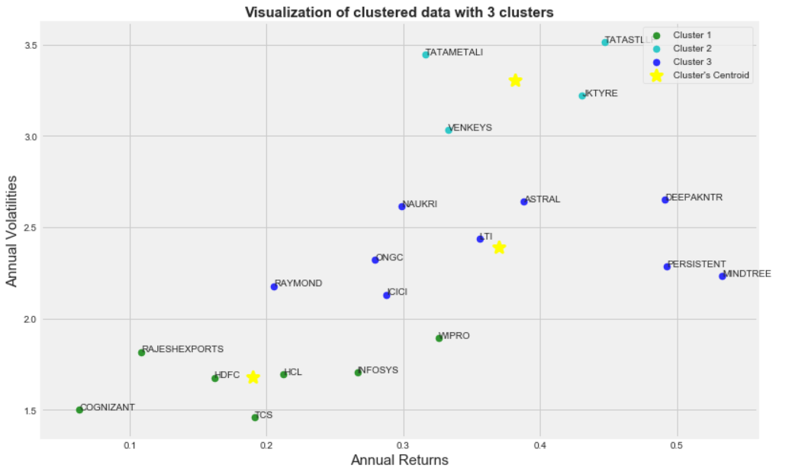
Diversification using Clustering

Slide 25
Trade Call Prediction using Classification
The most common question related to stocks is should we to buy, sell or hold the stock.
To answer this question we used classification and classified the already available data into above classes.
We tested different models to determine which would be better for this prediction
Logistic regression gives the best accuracy of 97%
Hence we use this classification model and predict the results for given period..

Slide 26
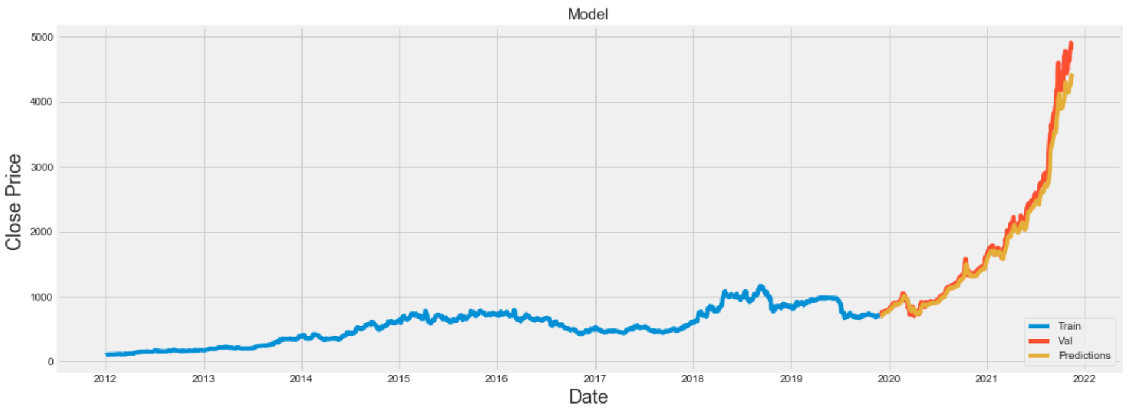
Stock Closing price prediction using LSTM
RMSE for LSTM is 164.41 which is so small compared to all the closing prices

Slide 27
Conclusion
The stock market is trending topic. Hence, many companies have taken the advantage by creating online applications which can work as brokers, have made tremendous profits out of it.
But everyone is focused on certain analysis and predictions which may not be sufficient enough for people to judge the company background and invest into the companies.
So, we built the system to overcome these drawbacks
The system focuses on thoroughly analysing a certain company using many different kinds of methods.
Instead of opting for quantitative analysis i.e analysing each and every stock in market, we opted for qualitative analysis i.e select limited but best companies to invest.
The system provides different analysis to check company background and prediction models to invest efficiently and make effective trade calls

Slide 28
Future Work
The aims are perfectly implemented, just need to integrate it in a single module which can analyse and predict data for any provided company
Build a user friendly, dynamic web application. So that it is easy for user to visualize the data.

Slide 29
Thank you!
Any Questions?

